Slide 1
Fibonacci Retracements
By Om Aditya

Slide 2
Who is Fibonacci?
• Leonardo Pisano, was born in Pisa during the 12th century, and he is most prominently recognized for his publication of the modern numbering sequence called Fibonacci series.
Although Leonardo was not responsible for discovering the number sequence, it was his publication of Liber Abaci in 1202 which introduced it to the West.

Slide 3
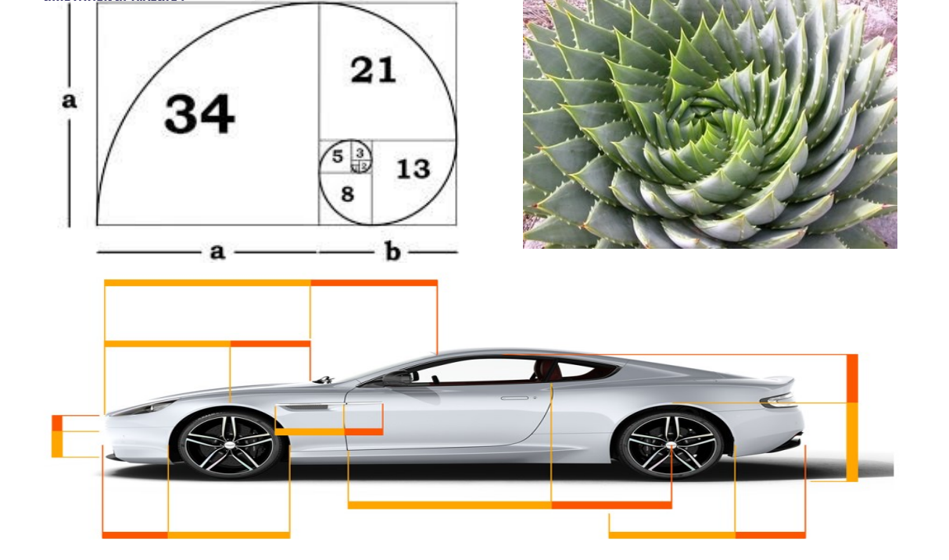
Real world examples

Slide 4
How we get Fibonacci levels
0, 1, 1, 2, 3, 5, 8, 13, 21, 34, 55, 89, 144, 233, 377, 610, 987 to infinity, and
the key Fibonacci ratios are 0%, 23.6%, 38.2%, 61.8%, and 100%.
The 0% & 100% levels are the start and end level, or high and low points of the wave.
The 0.236 ratio is found by dividing any number in the sequence by the number that is three places to the right.
The 0.382 ratio is found by dividing any number in the sequence by the number that is found two places to the right.
The key Fibonacci ratio (Golden Ratio) of 0.618 is derived by dividing any number in the sequence by the number that immediately follows it.
The 0.764 ratio is the result of subtracting 0.236 from the number 1.
Finally, the 0.500 ratio is a true recognized Fibonacci level, but still applied by many traders in technical analysis and a measure of a mid-level in the current wave.

Slide 5
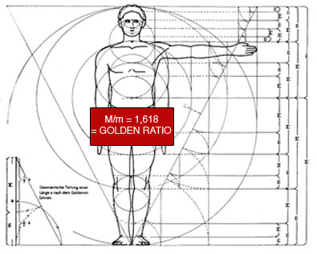
Golden Ratio

Slide 6
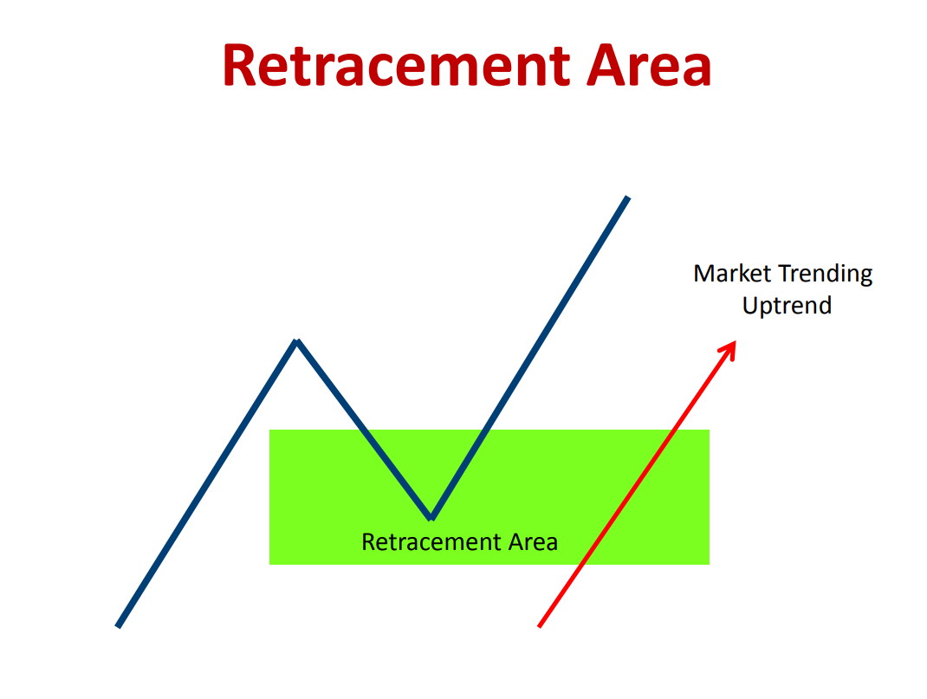
What is Fibonacci Retracement?
Fibonacci retracement level in forex technical analysis is the possibilities of the price making a retracement in market trending structure

Slide 7

Fibonacci Retracement
How does it work?
How you use it?
Predict areas of support and resistance
Locate opportunities to enter/exit a position

Slide 8
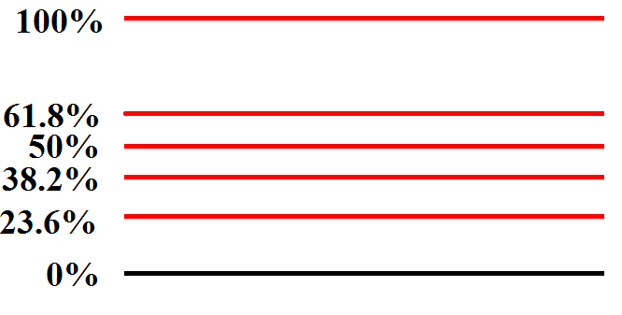
Fibonacci Levels
Notes:
Show how to get fib #’s

Slide 9
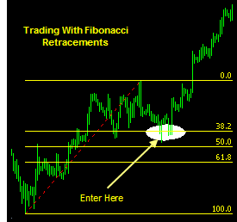

Slide 10
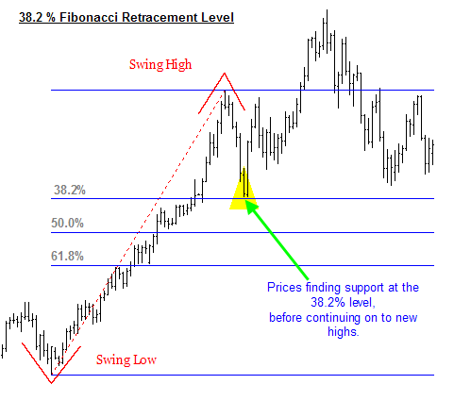
Example

Slide 11
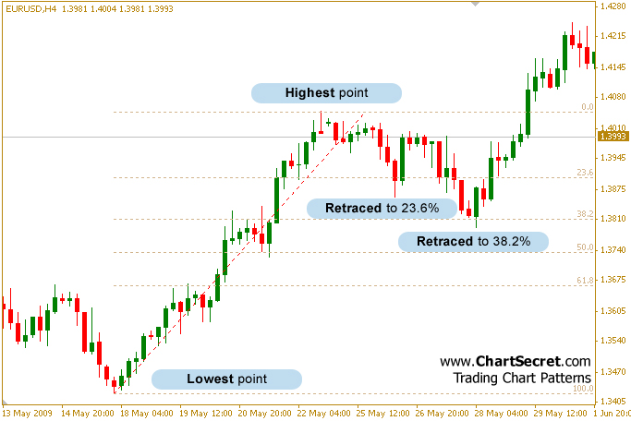
Example
0%
23.6%
38.2%
50%
61.8%
100%

Slide 12
The Golden Ratio
0, 1, 1, 2, 3, 5, 8, 13, 21, 34, 55, 89, 144, 233, 377, 610, 987 to infinity
If you divide one number by the previous one, the ratio approaches 1.618 – anywhere along the sequence. This is called the ‘golden ratio’. It has been used in classical architecture, art, and music as being the most perfect to our human senses. It is the number that mathematically describes the natural growth of systems (such as, some argue, the financial markets).

Slide 13
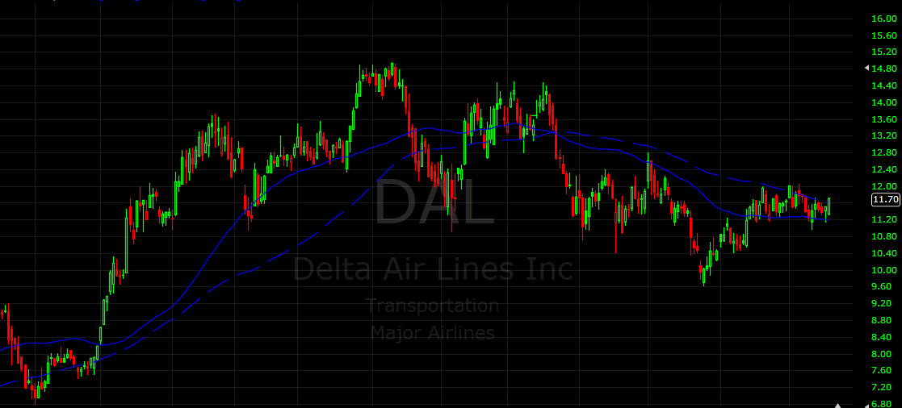
Hands-On Example

Slide 14
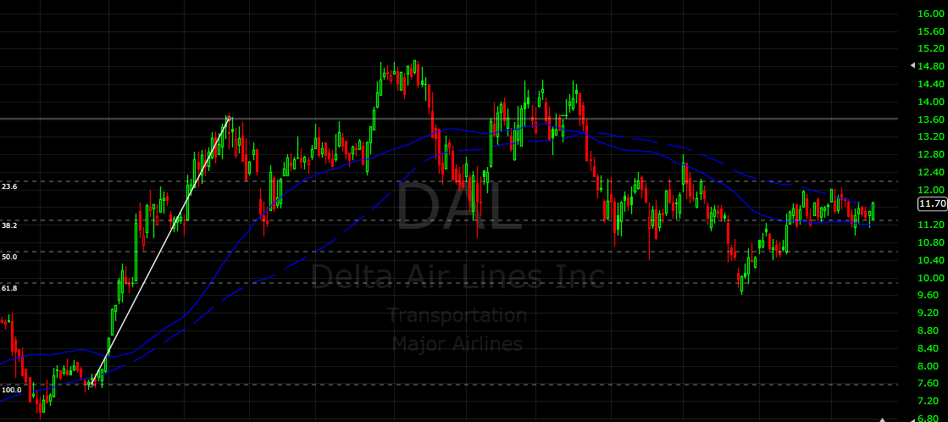
Hands-On Example
0%
23.6%
38.2%
50%
61.8%
100%

Slide 15
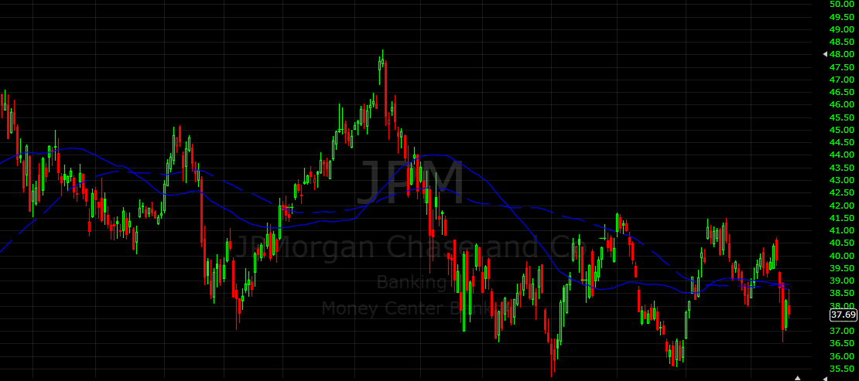
Hands-On Example

Slide 16
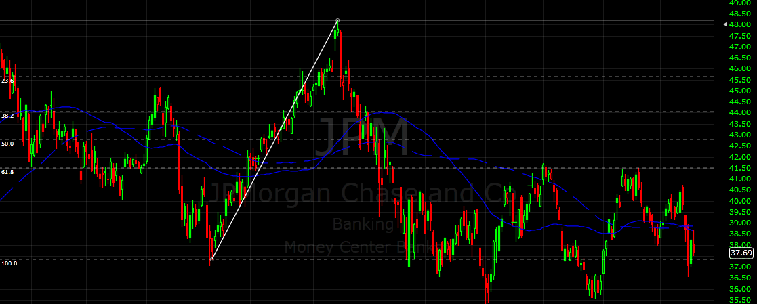
Hands-On Example
0%
23.6%
38.2%
50%
61.8%
100%

Slide 17
Hands-On Example

Slide 18
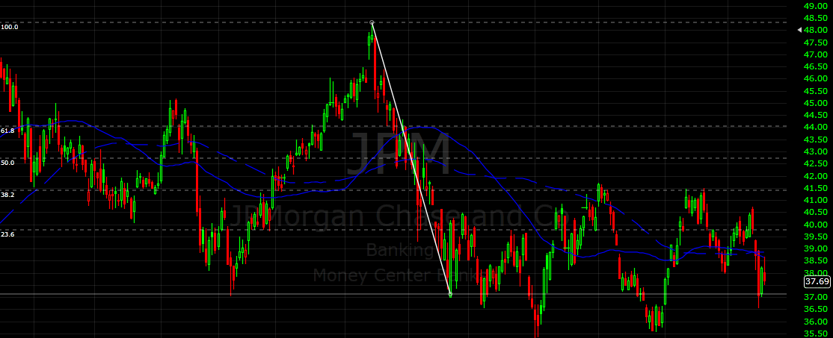
Hands-On Example
100%
61.8%
50%
38.2%
23.6%
0%

Slide 19
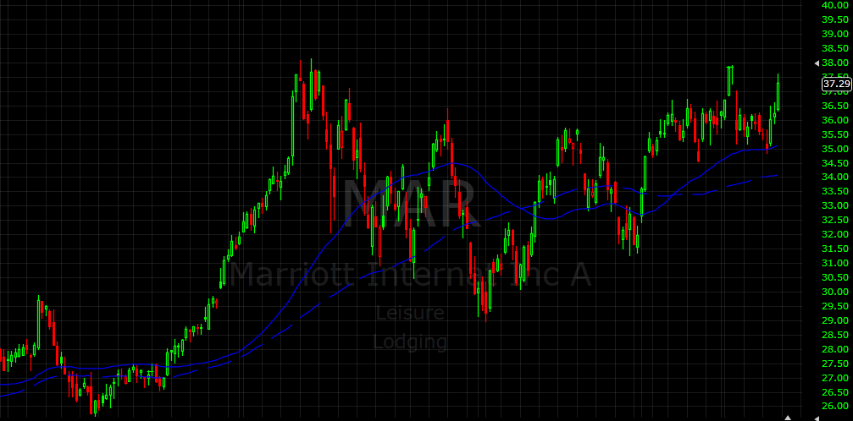
Hands-On Example

Slide 20
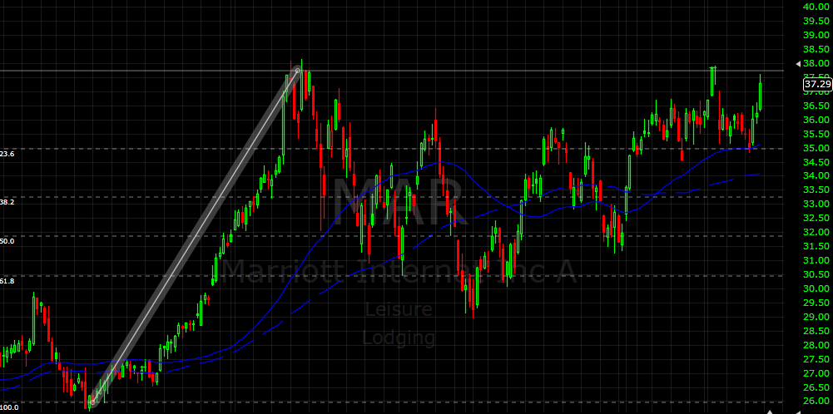
Hands-On Example
0%
23.6%
38.2%
50%
61.8%
100%

Slide 21
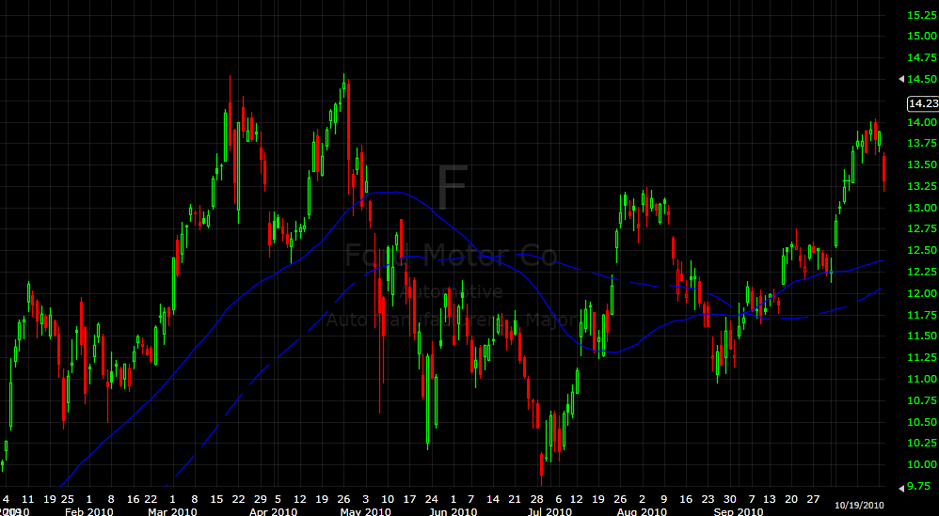
Applying the Concept

Slide 22
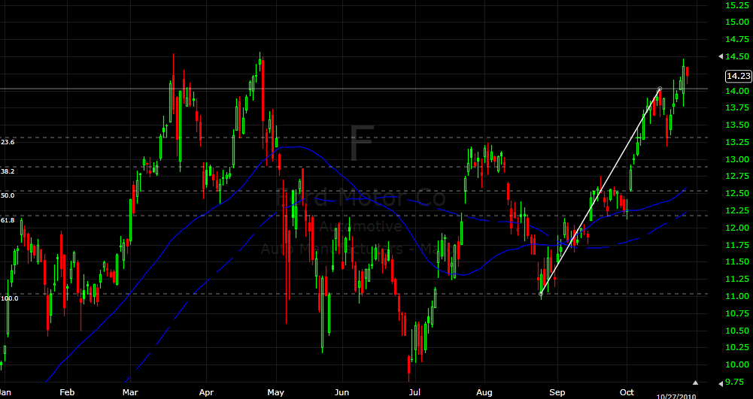
Applying the Concept
0%
23.6%
38.2%
50%
61.8%
100%

Slide 23
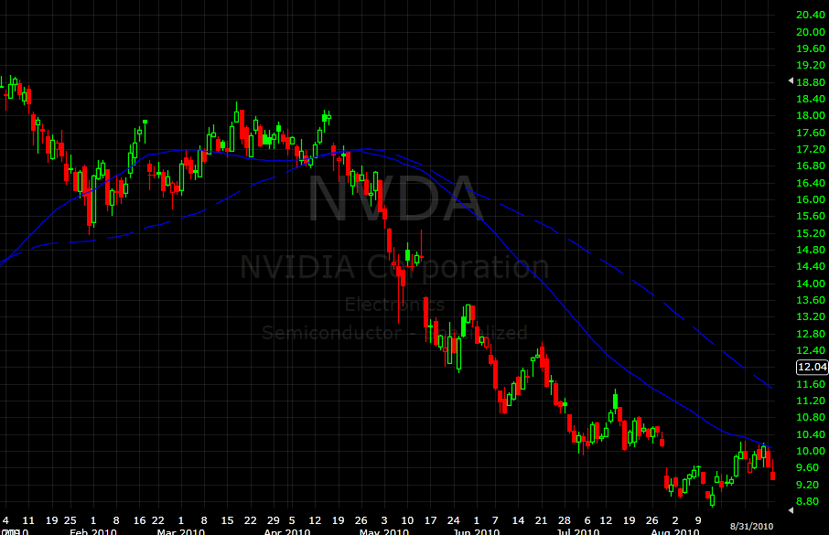
Applying the Concept

Slide 24
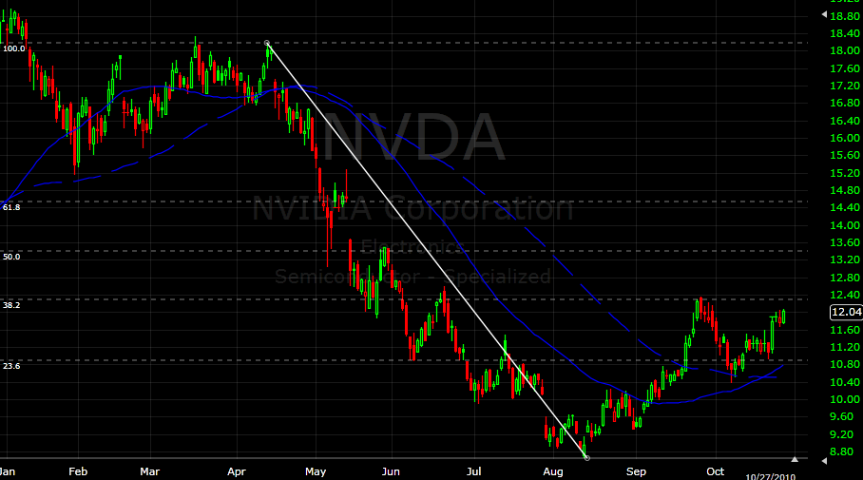
Applying the Concept
0%
23.6%
38.2%
50%
61.8%
100%

Slide 25
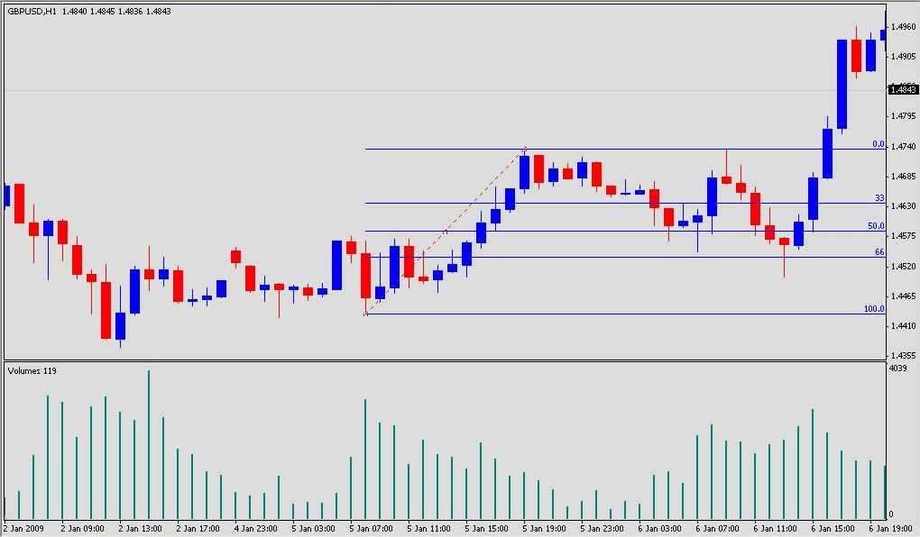
Fibonacci Retracement
Buy

Slide 26
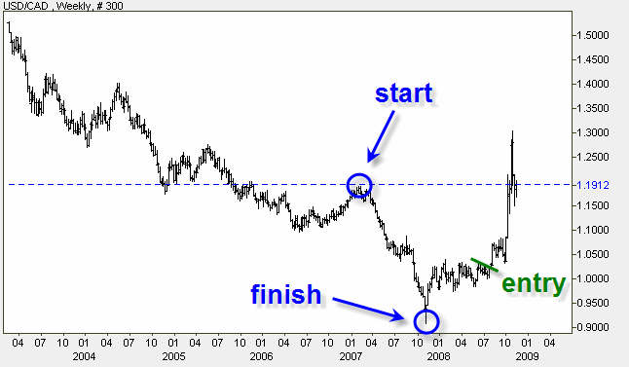
Applying Fibonacci
Notes:
Notice not exact prices… support becomes resistance when broken

Slide 27
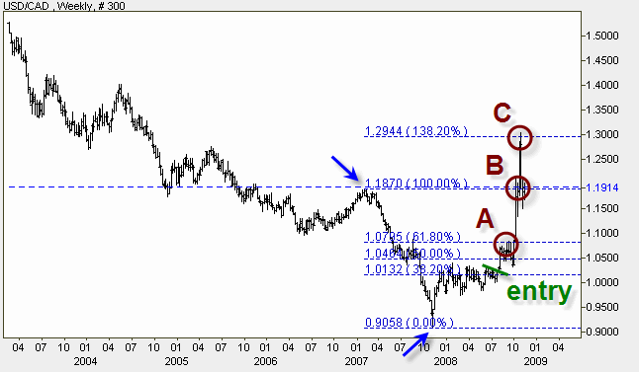
Notes:
Notice not exact prices… support becomes resistance when broken

Slide 28
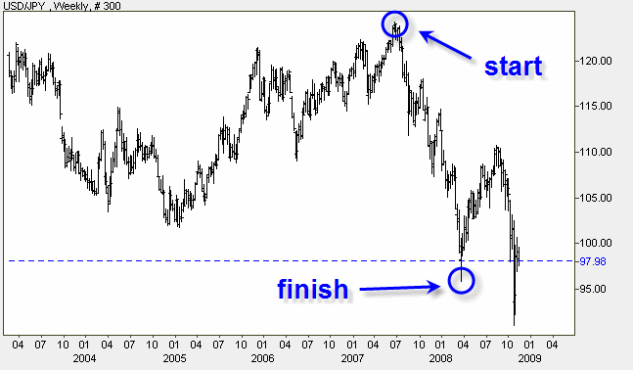
Notes:
Notice not exact prices… support becomes resistance when broken

Slide 29
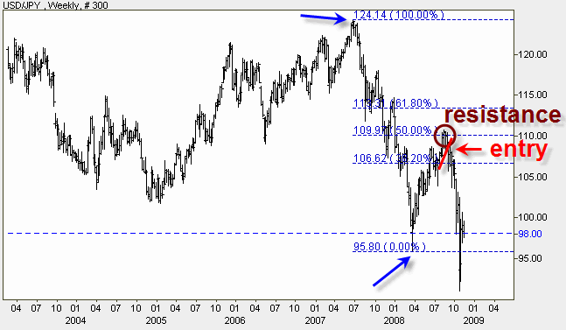
Notes:
Notice not exact prices… support becomes resistance when broken

Slide 30
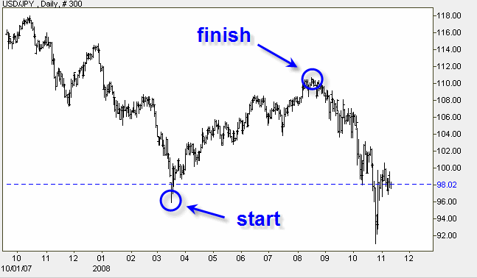
Notes:
Notice not exact prices… support becomes resistance when broken

Slide 31
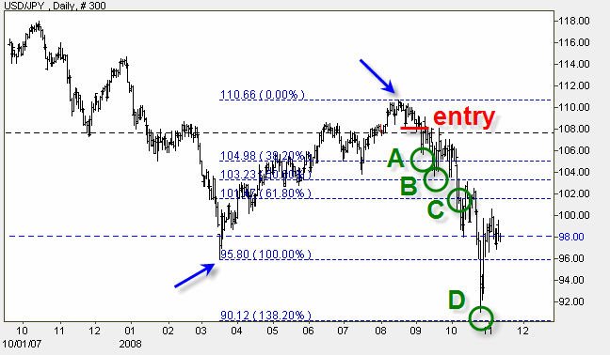
Notes:
Notice not exact prices… support becomes resistance when broken

Slide 32
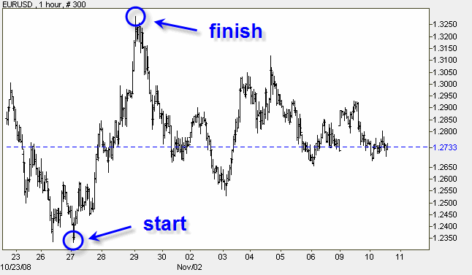
Notes:
Notice not exact prices… support becomes resistance when broken

Slide 33
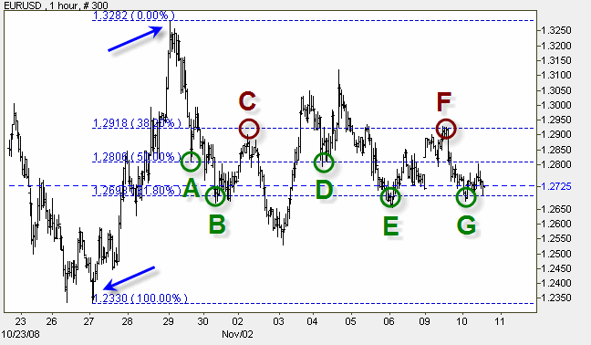
Notes:
Notice not exact prices… support becomes resistance when broken

Slide 34
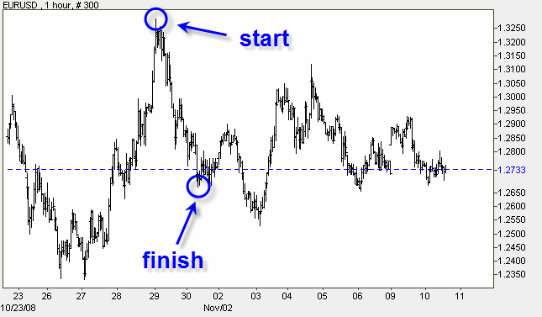
Notes:
Notice not exact prices… support becomes resistance when broken

Slide 35
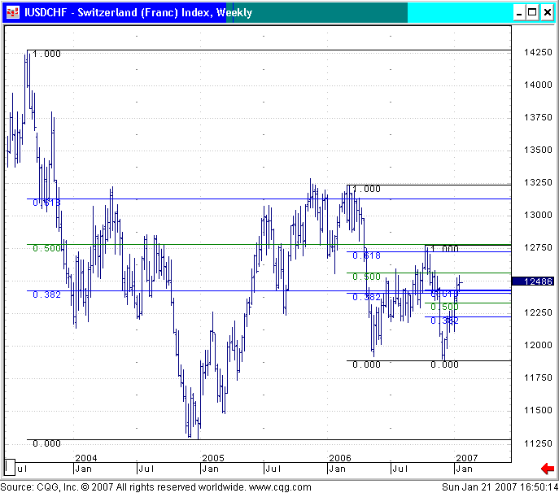
The retracements
of an initial trend
remain in effect for
as long as the
original high and low
remain in effect.

